Slide 1
COMPETENCY BASED TRAINING
A MAP TO SUCCESS
UNCLASSIFIED

Slide 2
What is United Services Military Apprenticeship Program (USMAP)?
USMAP is a formal military training program that provides enlisted Active Duty and Reserve Army, Marine Corps, Coast Guard, and Navy Service members the opportunity to improve their job skills and to complete their civilian apprenticeship requirements while serving their country. It is the largest registered apprenticeship program in the Department of Labor (DoL).
A registered apprenticeship is a formalized, structured training program which combines on-the-job training (OJT) and related technical instruction. Completion of the program can help qualify members for employment in a recognized civilian occupation upon fulfillment of military service.
USMAP transforms active-duty enlisted service members into highly skilled journeyworkers, equipping them for successful civilian careers post-military service. By integrating on-the-job training with technical instruction, USMAP creates a skilled workforce ready to meet industry demands. This no-cost program allows service members to earn nationally recognized Department of Labor certificates while fulfilling their military duties, enhancing both their military occupational specialty and future employability. USMAP's long-standing partnership with the Department of Labor ensures that participants receive credentials valued by civilian employers, easing the transition from military to civilian life. Moreover, the program serves as a vital pipeline for the defense industrial base, supplying well-trained professionals to fill critical workforce needs. By aligning military experience with civilian job requirements, USMAP effectively bridges the gap between military service and civilian employment, reducing transition stress for separating service members and addressing crucial workforce shortages.

Slide 3
USMAP and Department of Labor Standard
All apprenticeships must adhere to specific standards set by the Department of Labor. These requirements and standards ensure the validity of apprenticeships and enhance their value.
The Department of Labor (DoL) is the federal agency responsible for the administration of the National Apprenticeship System in the United States. USMAP is the DoL sponsor for all military apprenticeships. All DoL sponsors have a set of standards that set the guidelines for apprenticeships. These standards are tailored to fit USMAP’s military mission.
The USMAP Office further provides detailed program guidance, definitions, instructions and requirements in the USMAP guide found on the USMAP website under the Resources tab.

Slide 4
What are the Benefits?
No Cost
No off-duty hours required
National recognition
Documented work experience for civilian opportunities
Builds self-esteem
Gain work experience
Good for a lifetime
Become more marketable for future employment

Slide 5
Simple Qualifications
1. Must be Active-duty enlisted service member. Active duty includes all service members covered by these standards either who are on permanent active duty or who are members of the Selected Reserve, Guard or Air National Guard performing in the capacity of their Uniformed Service duties. Members of the Reserve or Guard must be currently on Active-Duty Orders for a minimum of 12 months to participate in USMAP.
2. Must have a minimum of 12 months remaining on enlistment contract.
3. Must be designated in a Rating/MOS applicable to an authorized apprenticeship trade. (There is an exception for those who are PACT Sailors)
4. Must have a working Common Access Card (CAC).
5. Must be assigned and working full time in requested Trade (not a collateral or extra duty) billet.
6. Must be working under supervision in occupation related to the trade selected.
7. Must have completed the required formal classroom instruction (training) hours for the trade.
8. Must not be a student currently in a military course or school.
9. Must fully read, agree and abide by the National Standards and USMAP reporting requirements.

Slide 6
Roles and Responsibilities
1. USMAP Office. The USMAP Office administers the program. The office provides administrative, programmatic, and policy oversight over the program as directed by Department of Labor (DOL) and the Department of Defense (DoD). The staff members provide advice and guidance in all USMAP matters and support the USMAP Coordinators.
2. Apprentice. An individual who is on active duty in the U.S. military, meets his or her Services’ qualification requirements and has entered into an apprenticeship agreement for learning the skills of a recognized occupation under the provisions of the Department of Labor. Ensure you have familiarized yourself with the contents of this manual and the National Apprenticeship Standards.
3. Supervisor. The Supervisor MUST be in the apprentice’s chain of command and MUST supervise the apprentice's working hours (Time Base Method) or job functions (Competency Base Method). The Supervisor must review monthly reports (if enrolled in Time Base method) or Job Functions (if enrolled in Competency Base method) submitted by the apprentice. The Supervisor MUST familiarize himself or herself with the contents of this manual and the National Apprenticeship Standards.
4. Final Approver. The final approver MUST be a commissioned officer in the apprentice’s immediate chain of command. Depending on the service, this can be the Division Officer, Department Head, Company Commander or other commissioned officer presiding over the apprentice. For units without commissioned officers (i.e. Coast Guard), can use the senior enlisted at the unit or supervising Government Service (GS) civilian (GS9 or above). The Final Approver MUST familiarize himself or herself with the contents of this manual and the National Apprenticeship Standards. Also, the Apprentice's Final Report Approver cannot have approved any of the apprentice's Monthly Reports or individual Job Function. The USMAP Coordinator cannot be the Final Approver for the entire command.

Slide 7
Two Different Apprenticeship Methods
Competency Based: Competency base enrollments are for more experienced Apprentices E-5 and above. These apprentices are expected to be able to demonstrate mastery of the competencies of their trade. Instead of Skill Areas and hours (Time Based method), the apprentice has Trade-specific Job Functions that contain Competencies. When the Apprentice has "mastered" a Competency, they submit it to their Supervisor for approval. Frocked E5 (Navy Only) are not eligible. Drillings Reservists are now eligible for this type of apprenticeship. The only time requirement is that you must be enrolled in the trade for a minimum of one year.
Time Based: The Time base Apprenticeship is the traditional model. It requires you to log 2,000 to 6,200 hours to complete the trade by capturing your day to day work for those of any enlisted paygrade. The apprenticeship is broken down into skill areas, known as a Work Processes Schedule (WPS), with a set number of hours for each skill area. This apprenticeship program has two components – Formal Classroom Instruction and On-the-Job Training. The only time requirement is that you must be enrolled in the trade for a minimum of one year
For this training, we are focusing on the competency base method.

Slide 8
WHAT YOU CANNOT DO IF ENROLLED IN THE COMPETENCY BASE METHOD
You cannot enroll in two trades – You can ONLY enroll into one trade at a time.
You cannot enroll or submit competencies while attending a military course or school.
You cannot enroll in a competency trade when you have less than 1 year on your enlistment contract.
You cannot have the same person approve your competencies and then your final report. The Supervisor and Final Approver must be two different people.
You cannot approve your own competencies. It must be your immediate supervisor and a commissioned officer in your chain of command for the final. For units without commissioned officers (i.e. Coast Guard), can use their supervising Government Service (GS) civilian (GS9 or above). IF there are no commissioned officers or GS civilian personnel then the senior enlisted at the unit can sign off as the final approver.

Slide 9
Selecting a Trade and Work Processes Schedule
Selecting a Trade:
Apprentices are only authorized to choose a trade that is related to his or her Rate/MOS and his or her current primary duty (what you do for your command). This is because you are required to perform a set number of hours of OJT or competencies to complete the requirements for your trade.
For USN Rates, some Trades have NEC requirements. You must have the NEC in order to enroll into that trade. This requirement is for both Time Based and Competency Based
For Competency Based Trades, you are is required to perform specific job functions.
Work Processes Schedule
Each trade is broken into Work Processes or Skill Areas. These Skill Areas or competencies form an outline of the tasks to be completed. The outline of tasks is called a Work Processes Schedule (WPS). The WPS also provides more information about the trade. It is simply a breakdown of the work experience to be completed. Another way to look at a WPS is it’s a blueprint to complete the trade.

Slide 10
Two Components
First Component of the Program
The first component is the completion of a formal classroom instruction hours that relates to the Trade. Every Trade requires related formal instruction training necessary to provide apprentices with knowledge in technical subjects related to the Trade. The instruction may be classroom, technical schools, or other approved means. “A” schools and MOS (Marines and Army) schools count regardless of length of school. This requirement cannot be waived. The Classroom Instructional hours ranges from 144 to 453 depending on the Trade.
After you receive your "Approved Enrollment Email," confirm that your Formal Classroom Instruction hours are documented. A statement will list the number of hours you have completed. There is nothing that you need to do with these Formal Classroom Instruction hours; they have been entered into your record by an USMAP Analyst as part of the enrollment process.
The Formal Classroom Instruction Hours CANNOT be waived. You cannot complete the Trade until you fulfill this requirement.
If you did not attend military training, you maybe able to use formal related civilian training, such as vocational schools, college classes, Trade schools, Personnel Qualification Standard (PQS) and correspondence courses to fulfill the formal classroom instruction hours.

Slide 11
Two Components
The Second Component for Competency Based Trades, the apprentice is required to perform specific competencies.
For Competency Based Trades, the apprentice is required to perform specific job functions. Competencies are similar to a Personnel Qualification Standard(s) (PQS).
Job functions are the specific tasks, duties and responsibilities associated with a particular position that define a role within an organization. It outlines what you are expected to accomplish or manage in your primary job.
Competency based enrollments are for more experienced apprentices E-5 and above. Frocked E-5s (Navy only) are not eligible for Competency based because the Navy is the only service that Frocks. Drilling Reservists are now eligible for Competency base trades. however, must be working in Rate and currently on Active-Duty Orders for a minimum of 12 months may participate in USMAP.

Slide 12
Competency Based Process
Instead of Skill Areas and hours (Time Based method), you have Trade-specific Job Functions that contain Competencies. When you have "mastered" the competencies, you then submit them to your supervisor for approval. You do not log hours or submit Monthly Status Reports, just the Competency. When all Competencies are approved, you will have to submit a Final Report. The final approver shall be a commissioned officer in the apprentice’s immediate chain of command. Depending on the service, this can be the Division Officer, Department Head, Company Commander or other commissioned officer presiding over the apprentice. For units without commissioned officers (i.e. Coast Guard), can use their supervising Government Service (GS) civilian (GS9 or above). IF there are no commissioned officers or GS civilian personnel then the senior enlisted at the unit can sign off as the final approver.

Slide 13
Competency Based Process
Requirements
You must be E5 and above. Frocked E5 are ineligible (Navy Only).
Must be enrolled for a minimum of 12 Months (before completion can be accomplished) and must complete all Competencies.
You must be assigned as a full-time billet.
You must not be a student currently in a military course or school.
You may only enroll in an apprenticeship that aligns with the occupation you are performing.
You must have the Formal Classroom Instruction hours and if the Trade is NEC driven, you must have the NEC for that Trade.

Slide 14
Competency Based Process
How to Enroll
USMAP self-service screen after CAC authentication
To enroll into a Trade, Click on “All Enrollments”

Slide 15
Competency Based Process
Enrollment
If you have been enrolled before, the page shows all the Trades you have enrolled in.
To enroll into a new Trade, click “START NEW REGISTRATION.” This page shows available Trades you are eligible to enroll in. You will only see the Trades that are associated with your Rate (Navy/Coast Guard)/MOS (Army/Marines).

Slide 16
Competency Based Process
Enrollment
0159D | ELECTRICIAN | Trade DESCRIPTION: Install, maintain, and repair electrical wiring, equipment, and fixtures. Ensure that work is in accordance with relevant codes. May install or service street lights, intercom systems, or electrical control systems. TASK PERFORMANCE: Demonstrate knowledge and skills for qualifying as Journeyworker. Applicable Job Qualification Requirements will be used as a guide in performing tasks and demonstrating knowledge in the following skill areas. Actual work time must be recorded in the Work Experience Log; each skill area must be completed. | Time Competency 1 year minimum
0169D | ELECTRONICS TECHNICIAN | Trade DESCRIPTION: Lay out, build, test, troubleshoot, repair, and modify developmental and production electronic components, parts, equipment, and systems, such as computer equipment, missile control instrumentation, electron tubes, test equipment, and machine tool numerical controls, applying principles and theories of electronics, electrical circuitry, engineering mathematics, electroni and electrical testing, and physics. Usually work under direction of engineering staff. TASK PERFORMANCE: Demonstrate knowledg and skills for qualifying as Journeyworker. Applicable Job Qualification Requirements will be used as a guide in performing tasks and demonstrating knowledge in the following skill areas. Actual work time must be recorded in the Work Experience Log; each skill area must be completed. | You have to be enrolled in the trade for a minimum of 1 year.
0465D | RADIO MECHANIC | Trade DESCRIPTION: Test or repair mobile or stationary radio transmitting and receiving equipment and two-way radio communications systems used in ship-to-shore communications and found in service and emergency vehicles. TASK PERFORMANCE: Demonstrate knowledge and skills for qualifying as Journeyworker. Applicable Job Qualification Requirements will be used as a guide in performing tasks and demonstrating knowledge in the following skill areas. Actual work time must be recorded in the Work Experience Log; each skill area must be completed. | Time Competency 1 year minimum
1038D | INTERNET WORKING TECHNICIAN | Trade DESCRIPTION: Analyze, test, troubleshoot, and evaluate existing network systems, such as local area network (LAN), wide area network (WAN), and Internet systems or a segment of a network system. Perform network maintenance to ensure networks operate correctly with minimal interruption. ** (Alternate Title: Computer Network Support Specialists) TASK PERFORMANCE: Demonstrate knowledge and skills for qualifying as Journeyworker. Applicable Job Qualification Requirements will be used as a guide in performing tasks and demonstrating knowledge in the following skill areas. Actual work time must be recorded in the Work Experience Log; each skill area must be completed. | Time Competency 1 year minimum
1 year minimum
Time
c Competency
e 1 year minimum
1 year minimum
1 year minimum

Slide 17
Competency Based Process
Enrollment
At the top right, the button “SWITCH TO TIME” button is used to switch your Trade to either time or competency. Once you switch, you can’t switch back. That button can only be used one time. So if you enrolled into the Competency Base Trade in error, send an email to (usmap@navy.mil) in order to switch from Competency to Time Based.

Slide 18
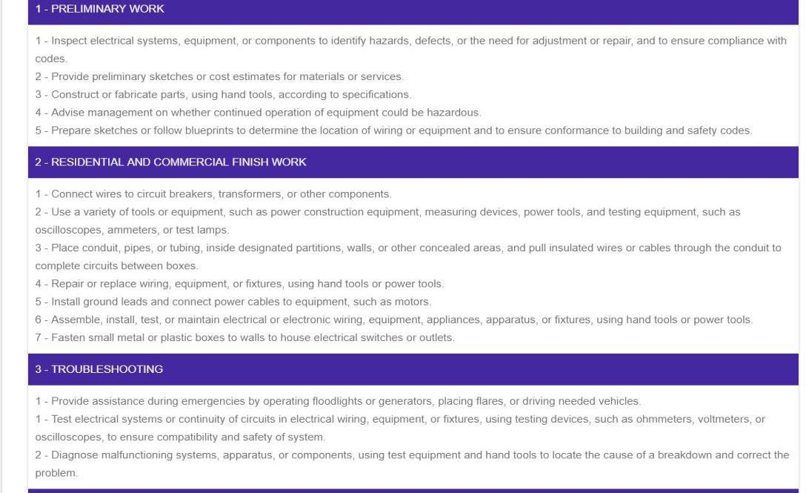
Competency Based Process
Enrollment
The below is an example of competencies. These competencies that you must demonstrate master, and your supervisor must concur Trade.

Slide 19
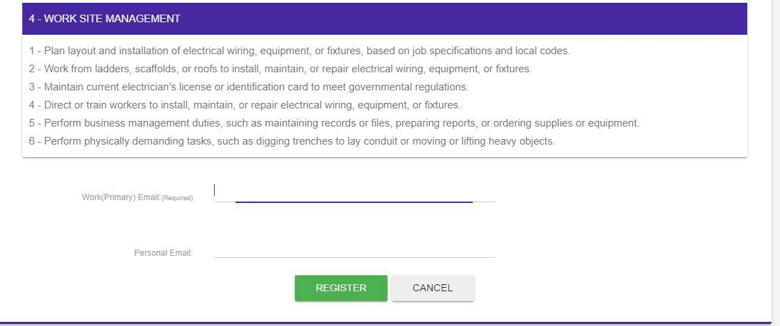
Competency Based Process
Enrollment
At the bottom of the page, you will enter your email. Then click on the “REGISTER” button.
This will send the registration to the USMAP Office.

Slide 20
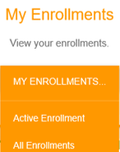
Competency Based Process
Once you receive your approval email, log back into your record. Select “Active Enrollment” from drop down menu under “My Enrollments”.
When you click on “Active Enrollment” the next screen is where you enter your Supervisor’s and Final Approver’s email. Then click “Edit Emails”.

Slide 21
Competency Based Process
Once Enrolled
This is where you need to enter your current Supervisor’s and Final Approver’s email. Ensure you type it correctly.
Supervisor should be the YOUR assigned immediate supervisor. The supervisor who assigns, monitors the work, and provides quality control oversight. There is no minimum paygrade requirement; however, we highly recommend the designated Supervisor be at least an E-5 or above and ideally at least one paygrade senior to the apprentice.
The final approver shall be a commissioned officer in the apprentice’s immediate chain of command. Depending on the service, this can be the Division Officer, Department Head, Company Commander or other commissioned officer presiding over the apprentice. . For units without commissioned officers (i.e. Coast Guard), can use their supervising Government Service (GS) civilian (GS9 or above). IF there are no commissioned officers or GS civilian personnel then the senior enlisted at the unit can sign off as the final approver.
Also, the Apprentice's Final Report Approver cannot have approved any of the apprentice's Monthly Reports or individual Competencies. The USMAP Coordinator cannot be the Final Approver for the entire command.

Slide 22
Competency Based Process
Competencies
You must demonstrate mastery of the Trade’s competencies. If you need to obtain a copy of the competencies, go to the USMAP website (https://usmap.osd.mil), Click on “Find an Eligible Trade,” select your Branch of Service, Select a rating/MOS and this will automatically filter the trades only available under the rating/MOS (Marines/Army).
Click on the plus sign, this is where you will find the Work Processes Schedule for Time Base and Competency Base

Slide 23
Competency Based Process
Work Processes Schedule
Click on the RAPIDS Code to open the WPS

Slide 24
Competency Based Process
Example of a Trade’s Work Processes Schedule (WPS) Competency Base

Slide 25
Competency Based Process
Competencies
All competencies will start out as “Working.” Once you have mastered the competency, you need to change “Working” to “Submitted” by clicking on the dropped down arrow.
You may submit multiple competencies for approval at the same time.
The Competency Process is a three step process:
Step 1 – Submit all competencies to be approved.
Step 2 – Once approved, you must meet the 1 year requirement
Step 3 - Submit the final report after one year.
NOTE: The final Report button will not appear in your record until you have reached the 12 month requirement.

Slide 26
Competency Based Process
Competencies
All competencies will start out as “Working.” Once you have mastered the competency, change “Working” to “Submitted” by clicking on the dropped down. You can submit multiple competencies for approval at the same time.

Slide 27
Competency Based Process
Competencies
Once you change ‘Working” to “Submitted,” scroll to the top of the page and click the green “Submit” button.” This will automatically send an email to your supervisor ONLY. The email doesn’t go to the final approver at this point.
Joe.Sailor.mil@us.navy.mil
diamond.r.carter.mil@us.navy.mil

Slide 28
Competency Based Process
Competencies
The link in the automated email is only good for 14 days. If your supervisor does not approve it within the 14 days, you have the ability to resubmit your competencies to your supervisor.
Also under the Action Section, it will show you when you have submitted your competencies to your supervisor. See example above.

Slide 29
Competency Based Process
If the Approver does not receive the email:
ALWAYS check with your supervisor to ensure he or she received an email from the USMAP automated system. It is in your best interest not to wait; this is how your competencies will be approved. Sometimes, the USMAP automated emails end up in the Junk Email folder due to server firewalls, ensure the supervisor checks his or her junk email folder first. “If” your approver did not receive an email please adhere to the following steps to do so:
Note: Do not change your supervisor email to another person email until you contact the USMAP Office.
Step 1) You must contact the USMAP office by emailing USMAP@navy.mil and request that a Program Analyst verify that an email was sent out to your approver. Sometimes your command server blocks the automated email, so a Program Analyst at the USMAP Office will have to reset your competencies.

Slide 30
Competency Based Process
Step 2) An USMAP Analyst has to reset your competencies back to “Working” so you can resubmit to your supervisor. Check with your supervisor to verify whether he or she received the email with the link to approve your competencies. If they did not receive an email, go to step 3.
Step 3) Have your approver review your Competencies or Final Report from your computer and if he or she approves the hours you logged, have him or her email USMAP@navy.mil and request to manually approve the submitted report on his or her behalf. To expedite the request, your DoD Id#, Full Name, Rate/Rank, as well as the specific report(s) to be approved should be included in that email.

Slide 31
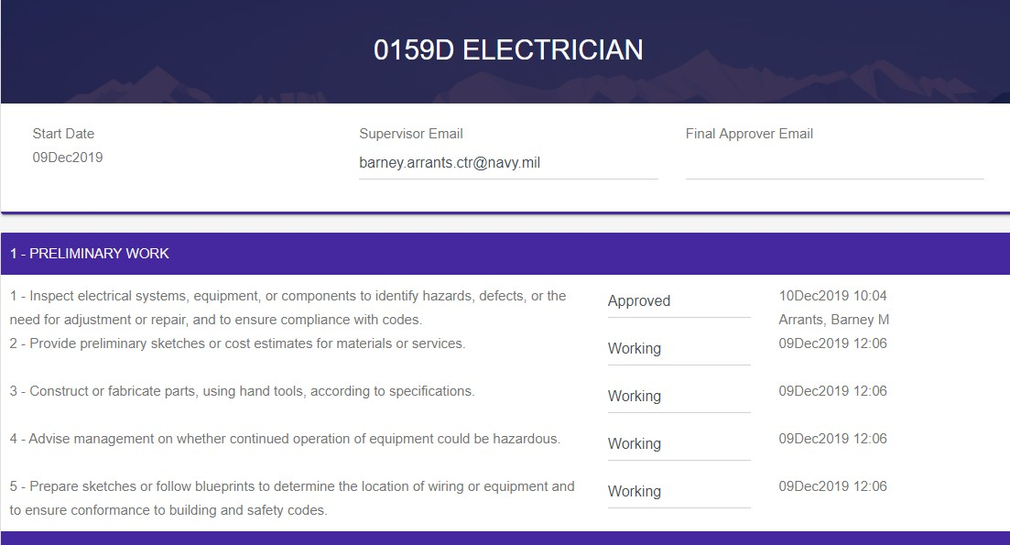
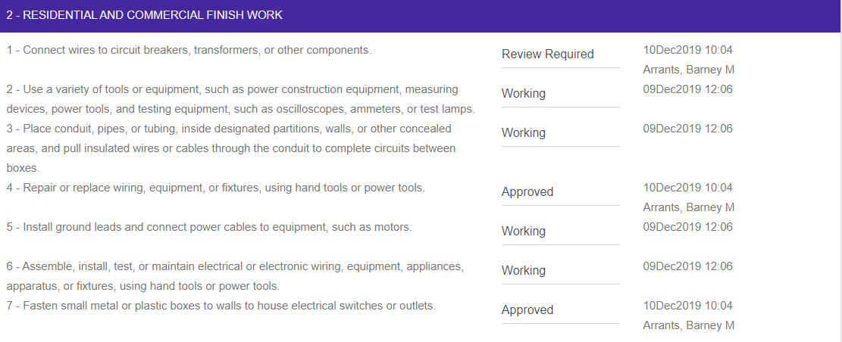
Competency Based Process
Joseph Sailor.mil@us.navy.mil
diamond.r.carter.mil@us.navy.mil
This is an example where the approver the competency.

Slide 32
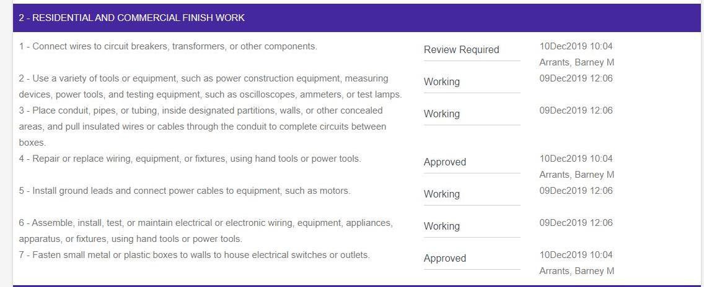
Competency Based Process
Approval and Review Required
This is an example where the approver did not feel the competency was mastered.

Slide 33
Competency Based Process
Approval and Review Required
Member submits “Competencies” once mastered for approval until all competencies are approved. Once your approver approves or selects “Review Required,” you will receive the following email: usmap_donotreply@navy.mil <usmap_donotreply@navy.mil>
To: Member’s name
Subject: USMAP Competency approved
Member’s Name, your Competency report has been modified.
Please review competency statuses, the following changes have occurred.
Approved - Inspect electrical systems, equipment, or components to identify hazards, defects, or the need for adjustment or repair, and to ensure compliance with codes.
Review Required - Connect wires to circuit breakers, transformers, or other components. Approved - Repair or replace wiring, equipment, or fixtures, using hand tools or power tools. Approved - Fasten small metal or plastic boxes to walls to house electrical switches or outlets.
Approved - Perform physically demanding tasks, such as digging trenches to lay conduit or moving or lifting heavy objects.
When the Final report (report documenting completion of Apprenticeship requirements) is approved; the Apprenticeship status changes to complete.
Member submits “Final Report” (all “competencies in all Job Functions have been approved or waived, and Instructional hours are completed). Note: The Final Report cannot be submitted for approval until a minimum of 12 months in the trade. Final Approver must be a commissioned officer in your chain of command.
Trades are automatically cancelled after 18 months without log in activity.

Slide 34
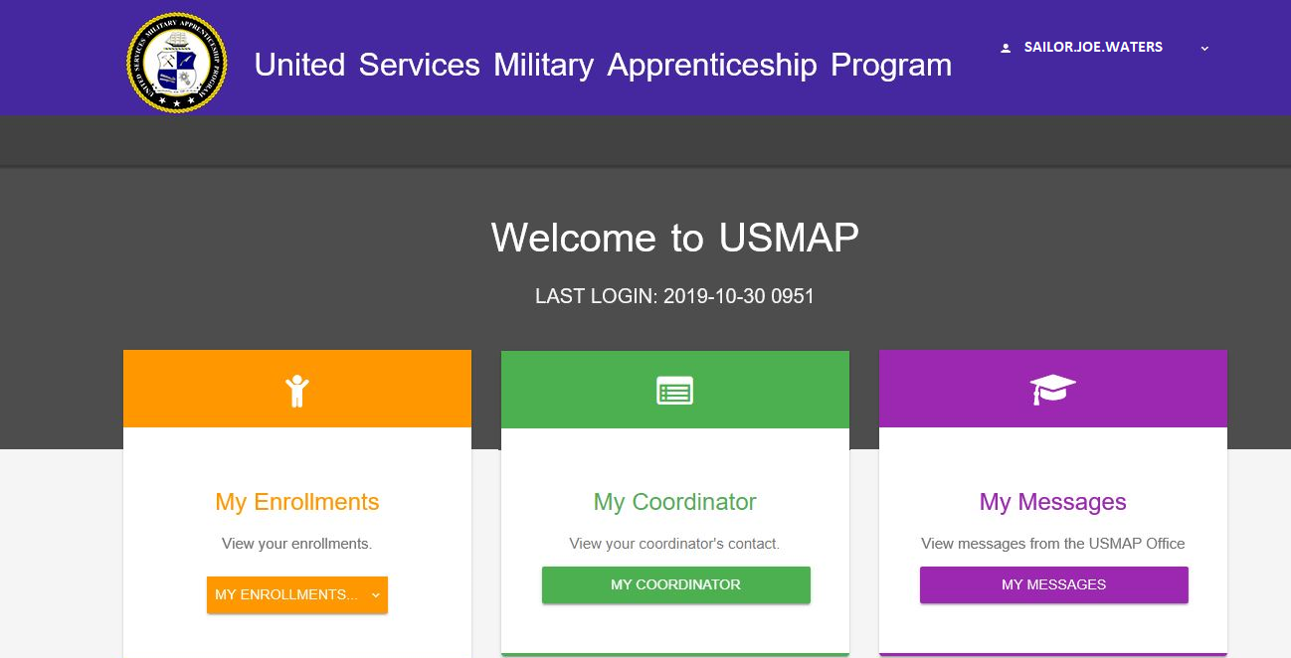
Competency Based Process
Certificate and Journeyworker Card
Log back into your record. Click “Enrollments.”

Slide 35
Competency Based Process
Certificate and Journeyworker Card
Use the drop-down arrow and click “All Enrollments”
This will bring up all the enrollments in your record. Find the Trade you just completed and click “Completion Certificate.” Example is on the next slide.

Slide 36
Competency Based Process
Certificate and Journeyworker Card
Once you click “Completion Certificate” and the Department of Labor Completion Certificate will open on the computer.

Slide 37
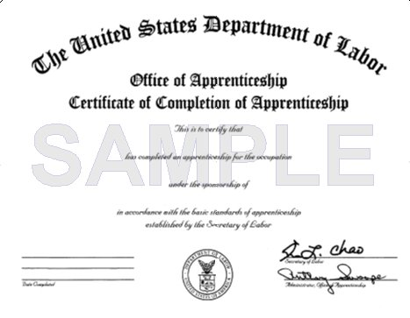
Competency Based Process
Certificate and Journeyworker Card
You can reprint your certificate and journeyworker card as needed as needed in the future with CAC access. Once you leave the military, you will have to request a copy of your DOL certificate and journey worker card by email the USMAP Office.
Notice! This is not an USMAP Completion Certificate and Journeyworker card -rather it is a certificate issued by the Department of Labor and should be referred to as such. Note It is recommended that you print or save the trades Work Processes Schedule and keep it along with your Department of Labor Completion Certificate. It might be useful once you transition to a civilian.

Slide 38
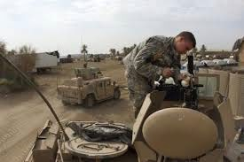
USMAP INFORMATION
Web site: https://usmap.osd.mil/ E-mail: usmap@navy.mil or usmap@livehelpnow.net
Phone: | 1-850-452-6699
DSN: | 459
FAX: | 850-452-6897

