Slide 1
TIME BASE TRAINING
A MAP TO SUCCESS
UNCLASSIFIED

Slide 2
What is United Services Military Apprenticeship Program (USMAP)?
USMAP is a formal military training program that provides enlisted Active Duty and Reserve Army, Marine Corps, Coast Guard, and Navy Service members the opportunity to improve their job skills and to complete their civilian apprenticeship requirements while serving their country. It is the largest registered apprenticeship program in the Department of Labor (DoL).
A registered apprenticeship is a formalized, structured training program which combines on-the-job training (OJT) and related technical instruction. Completion of the program can help qualify members for employment in a recognized civilian occupation upon fulfillment of military service.
USMAP transforms active-duty enlisted service members into highly skilled journeyworkers, equipping them for successful civilian careers post-military service. By integrating on-the-job training with technical instruction, USMAP creates a skilled workforce ready to meet industry demands. This no-cost program allows service members to earn nationally recognized Department of Labor certificates while fulfilling their military duties, enhancing both their military occupational specialty and future employability. USMAP's long-standing partnership with the Department of Labor ensures that participants receive credentials valued by civilian employers, easing the transition from military to civilian life. Moreover, the program serves as a vital pipeline for the defense industrial base, supplying well-trained professionals to fill critical workforce needs. By aligning military experience with civilian job requirements, USMAP effectively bridges the gap between military service and civilian employment, reducing transition stress for separating service members and addressing crucial workforce shortages.

Slide 3
USMAP and Department of Labor Standard
All apprenticeships must adhere to specific standards set by the Department of Labor. These requirements and standards ensure the validity of apprenticeships and enhance their value.
The Department of Labor (DoL) is the federal agency responsible for the administration of the National Apprenticeship System in the United States. USMAP is the DoL sponsor for all military apprenticeships. All DoL sponsors have a set of standards that set the guidelines for apprenticeships. These standards are tailored to fit USMAP’s military mission.
The USMAP Office further provides detailed program guidance, definitions, instructions and requirements in the USMAP guide found on the USMAP website under the Resources tab.

Slide 4
What are the Benefits?
No Cost
No off-duty hours required
National recognition
Documented work experience for civilian opportunities
Builds self-esteem
Gain work experience
Good for a lifetime
Become more marketable for future employment

Slide 5
Simple Qualifications
1. Must be Active-duty enlisted service member. Active duty includes all service members covered by these standards either who are on permanent active duty or who are members of the Selected Reserve, Guard or Air National Guard performing in the capacity of their Uniformed Service duties. Members of the Reserve or Guard must be currently on Active-Duty Orders for a minimum of 12 months to participate in USMAP.
2. Must have a minimum of 12 months remaining on enlistment contract.
3. Must be designated in a Rating/MOS applicable to an authorized apprenticeship trade. (There is an exception for those who are PACT Sailors)
4. Must have a working Common Access Card (CAC).
5. Must be assigned and working full time in requested Trade (not a collateral or extra duty) billet.
6. Must be working under supervision in occupation related to the trade selected.
7. Must have completed the required formal classroom instruction (training) hours for the trade.
8. Must not be a student currently in a military course or school.
9. Must fully read, agree and abide by the National Standards and USMAP reporting requirements.

Slide 6
Roles and Responsibilities
1. USMAP Office. The USMAP Office administers the program. The office provides administrative, programmatic, and policy oversight over the program as directed by Department of Labor (DOL) and the Department of Defense (DoD). The staff members provide advice and guidance in all USMAP matters and support the USMAP Coordinators.
2. Apprentice. An individual who is on active duty in the U.S. military, meets his or her Services’ qualification requirements and has entered into an apprenticeship agreement for learning the skills of a recognized occupation under the provisions of the Department of Labor. Ensure you have familiarized yourself with the contents of this manual and the National Apprenticeship Standards.
3. Supervisor. The Supervisor MUST be in the apprentice’s chain of command and MUST supervise the apprentice's working hours (Time Base Method) or job functions (Competency Base Method). The Supervisor must review monthly reports (if enrolled in Time Base method) or Job Functions (if enrolled in Competency Base method) submitted by the apprentice. The Supervisor MUST familiarize himself or herself with the contents of this manual and the National Apprenticeship Standards.
4. Final Approver. The final approver MUST be a commissioned officer in the apprentice’s immediate chain of command. Depending on the service, this can be the Division Officer, Department Head, Company Commander or other commissioned officer presiding over the apprentice. For units without commissioned officers (i.e. Coast Guard), can use the senior enlisted at the unit or supervising Government Service (GS) civilian (GS9 or above). The Final Approver MUST familiarize himself or herself with the contents of this manual and the National Apprenticeship Standards. Also, the Apprentice's Final Report Approver cannot have approved any of the apprentice's Monthly Reports or individual Job Function. The USMAP Coordinator cannot be the Final Approver for the entire command.

Slide 7
Two Different Apprenticeship Methods
Time Based: The Time base Apprenticeship is the traditional model. It requires you to log 2,000 to 6,200 hours to complete the trade by capturing your day to day work for those of any enlisted paygrade. The apprenticeship is broken down into skill areas, known as a Work Processes Schedule (WPS), with a set number of hours for each skill area. This apprenticeship program has two components – Formal Classroom Instruction and On-the-Job Training. The only time requirement is that you must be enrolled in the trade for a minimum of one year.
Competency Based: Competency base enrollments are for more experienced Apprentices E-5 and above. These apprentices are expected to be able to demonstrate mastery of the competencies of their trade. Instead of Skill Areas and hours (Time Based method), the apprentice has Trade-specific Job Functions that contain Competencies. When the Apprentice has "mastered" a Competency, they submit it to their Supervisor for approval. Frocked E5 (Navy Only) are not eligible. The only time requirement is that you must be enrolled in the trade for a minimum of one year.
For this training, we are focus on Time base method.

Slide 8
WHAT YOU CANNOT DO IN USMAP
You cannot enroll in two trades – You can ONLY enroll into one trade at a time.
You cannot enroll or log hours while attending a military course or school.
You cannot Back date. The Department of Labor does not allow backdating of the initial enrollment in any apprenticeship, time or competency. You only log hours from your enrollment date forward.
You cannot enroll in a trade when you have less than 1 year on your enlistment contract.
You cannot transfer hours from one trade to another. Each trade has its own Work Processes Schedule (WPS). Each regardless of type, is considered a standalone apprenticeship.
You cannot have the same person approve your monthly reports and then your final report. The Supervisor and Final Approver for any apprenticeship must be two different people.
You cannot approve your own hours. It must be your immediate supervisor and a commissioned officer in your chain of command for the final. For units without commissioned officers (i.e. Coast Guard), can use their supervising Government Service (GS) civilian (GS9 or above). IF there are no commissioned officers or GS civilian personnel then the senior enlisted at the unit can sign off as the final approver.
You cannot edit hours that have been approved by a supervisor. Pay attention to where you place your hours, ensure you do not over log hours in the Skills areas.

Slide 9
Selecting a Trade and Work Processes Schedule
Selecting a Trade:
Apprentices are only authorized to choose a trade that is related to his or her Rate/MOS and his or her current primary duty (what you do for your command). This is because you are required to perform a set number of hours of OJT to complete the requirements for your trade.
For USN Rates, some Trades have NEC requirements. Must have the NEC in order to enroll into that trade. This requirement is for both Time Based and Competency Based
Work Processes Schedule
Each trade is broken into Work Processes or Skill Areas. These Skill Areas form an outline of the tasks to be completed. The outline of tasks is called a Work Processes Schedule (WPS). The WPS also provides more information about the trade. It is simply a breakdown of the work experience to be completed. Another way to look at a WPS is it’s a blueprint to complete the trade.

Slide 10
Two Components
First Component
The first component is the completion of a formal classroom instruction hours that relates to the Trade. Every Trade requires related formal instruction training necessary to provide apprentices with knowledge in technical subjects related to the Trade. The instruction may be classroom, technical schools, or other approved means. “A” schools and MOS (Marines and Army) schools count regardless of length of school. This requirement cannot be waived. The Classroom Instructional hours ranges from 144 to 453 depending on the Trade.
After you receive your "Approved Enrollment Email," confirm that your Formal Classroom Instruction hours are documented. A statement will list the number of hours you have completed. There is nothing that you need to do with these Formal Classroom Instruction hours; they have been entered into your record by an USMAP Analyst as part of the enrollment process.
The Formal Classroom Instruction Hours CANNOT be waived. You cannot complete the Trade until you fulfill this requirement.
If you did not attend military training, you maybe able to use formal related civilian training, such as vocational schools, college classes, Trade schools, Personnel Qualification Standard (PQS) and correspondence courses to fulfill the formal classroom instruction hours.

Slide 11
Two Components
The Second Component is On the Job Training (OJT) (Time Base) and for Competency Based Trades, the apprentice is required to perform specific job functions.
For Time Base Trades: OJT encompasses the skills and work experiences learned while doing the actual job. The amount of OJT hours required to complete your apprenticeship is Trade related and will differ from Trade to Trade. The OJT total work hours are between 2,000 to 6,200 hours. These hours must be completed, documented, and approved.
Skill areas are broad categories or fields encompassing a group of related skills abilities, knowledge, and experience often use to describe areas of expertise.

Slide 12
Timed Based Process
Time based enrollments is where you record the hours you work according to the Trade’s Work Process Schedule.
Requirements
Be Active duty enlisted service member. Active duty includes all service members covered by these standards either who are on permanent active duty or who are members of the Reserve, Guard or Air National Guard performing in the capacity of their Uniformed Service duties. Drilling Reservists must be on Active Duty Orders for a minimum of 12 months.
Have a minimum of 12 months remaining on enlistment contract.
Must be designated in a Rating/MOS applicable to an authorized apprenticeship Trade. However PACT Sailors can enroll in Computer Operator only.
Must not be a student currently in a military course or school.
Be assigned and working full time in requested Trade (not a collateral or extra duty) billet.
Be working under supervision in occupation.
Agree to abide by the National Standards and USMAP reporting requirements.

Slide 13
Timed Based Process
How to Enroll
USMAP self-service screen after CAC authentication
To enroll into a Trade, Click on “All Enrollments”

Slide 14
Timed Based Process
Enrollment
If you have been enrolled before, the page shows all the Trades you have enrolled in.
To enroll into a new Trade, click “START NEW REGISTRATION.” This page shows available Trades you are eligible to enroll in. You will only see the Trades that are associated with your Rate (Navy/Coast Guard)/MOS (Army/Marines).

Slide 15
Timed Based Process
Enrollment
0159D | ELECTRICIAN | Trade DESCRIPTION: Install, maintain, and repair electrical wiring, equipment, and fixtures. Ensure that work is in accordance with relevant codes. May install or service street lights, intercom systems, or electrical control systems. TASK PERFORMANCE: Demonstrate knowledge and skills for qualifying as Journeyworker. Applicable Job Qualification Requirements will be used as a guide in performing tasks and demonstrating knowledge in the following skill areas. Actual work time must be recorded in the Work Experience Log; each skill area must be completed. | Time 1 year minimum Competency 1 year minimum
0169D | ELECTRONICS TECHNICIAN | Trade DESCRIPTION: Lay out, build, test, troubleshoot, repair, and modify developmental and production electronic components, parts, equipment, and systems, such as computer equipment, missile control instrumentation, electron tubes, test equipment, and machine tool numerical controls, applying principles and theories of electronics, electrical circuitry, engineering mathematics, electronic and electrical testing, and physics. Usually work under direction of engineering staff. TASK PERFORMANCE: Demonstrate knowledge and skills for qualifying as Journeyworker. Applicable Job Qualification Requirements will be used as a guide in performing tasks and demonstrating knowledge in the following skill areas. Actual work time must be recorded in the Work Experience Log; each skill area must be completed. | Time 1 year minimum Competency 1 year minimum

Slide 16
Timed Based Process
Enrollment
When you click on the trade you want to enroll in, the below is an example of the what you will see. Before you register for the trade, read over each skill area to ensure you qualify for that trade.

Slide 17
Timed Based Process
At the top right, the button “SWITCH TO COMPETENCY” button is used to switch your Trade to either timed or competency (E-5 and above). Once you switch, you can’t switch back. It can only be used one time. So if you enrolled into the Time Based Trade in error, send an email (usmap@navy.mil) to switch you from Time to Competency Base.

Slide 18
Timed Based Process
At the bottom of the page, you will enter your email. Then click on the “REGISTER” button.
This will send the registration to the USMAP Office.

Slide 19
Timed Based Process
Work Processes Schedule (WPS)
Each Trade is broken into Skill Areas. These Skill Areas form an outline of the tasks to be completed and the work hours required in each Skill Area. The outline of tasks is called a Work Processes Schedule (WPS). The WPS also provides more information about the Trade. It is simply a breakdown of the work experience to be completed. Another way to look at a WPS is it’s a blueprint to complete the Trade.
If you need to obtain a copy of the WPS, go to the USMAP website (https://usmap.osd.mil), Click on “Find an Eligible Trade,” select your Branch of Service, Select a rating/MOS and this will automatically filter the trades only available under the rating/MOS (Marines/Army).
Example of how to find the trade’s WPS is on the next slide.

Slide 20
Timed Based Process
Example of where to find the trade’s WPS
Click on the plus sign, this is where you will find the Work Processes Schedule for Time Base and Competency Base
Click on the RAPIDS Code to open the WPS

Slide 21
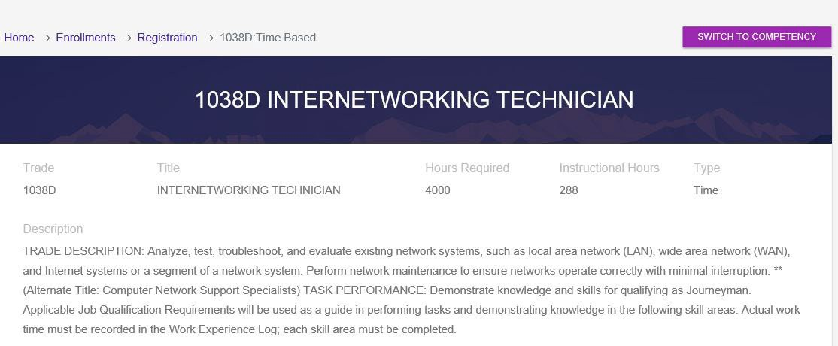
Timed Based Process
Work Processes Schedule (WPS)
Each Trade is broken into Skill Areas. These Skill Areas form an outline of the tasks to be completed and the work hours required in each Skill Area. The outline of tasks is called a Work Processes Schedule (WPS). The WPS also provides more information about the Trade. It is simply a breakdown of the work experience to be completed. Another way to look at a WPS is it’s a blueprint to complete the Trade.
Below is a SAMPLE WPS. The WPS will be broken down into two parts, so you can better understand it
First part – Trade information and description of the Trade. 1038D is the RAPIDS code that identifies the Trade. This also shows the title of the Trade, hours that are required, instructional hours and type of apprenticeship.

Slide 22
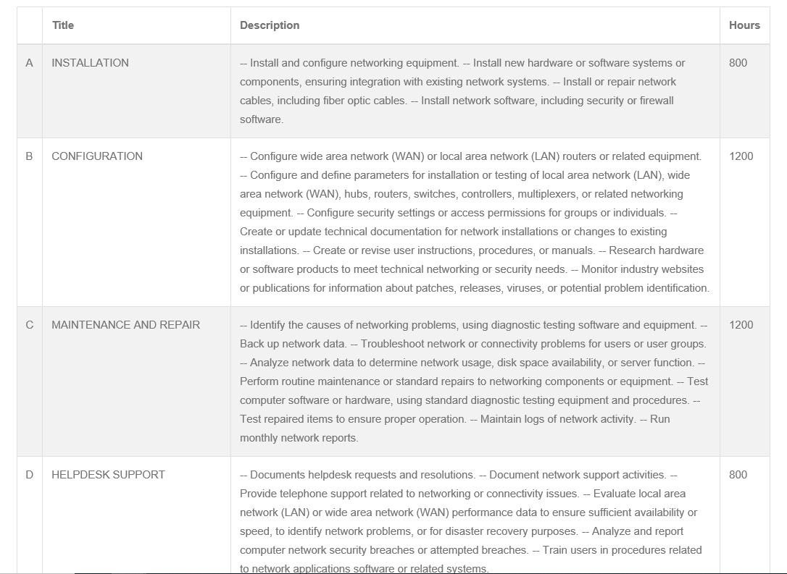
Timed Based Process
Second part of the WPS is a breakdown of the work experience and hours to be completed. Again, look at this as your blue print to complete the Trade.
Skill Areas form an outline of the tasks to be completed and the work hours required in each Skill Area. Skill Areas
can range from A to Z, A to C, etc. To complete the Trade, all Skill Area work hours must be at zero. The total hours can be at zero, however if each Skill Area isn’t at zero, the Trade is not complete.
The below is a SAMPLE of Skill Area on the WPS.
Each Trade is broken down into Skill Areas.
Hours required per Skill Area

Slide 23
Timed Based Process
Every Trade requires related formal instruction training necessary to provide apprentices with knowledge in technical subjects related to the Trade. The instruction may be classroom, technical schools, or other approved means. “A” schools and MOS (Marines and Army) schools count regardless of length of school. This requirement cannot be waived. The Classroom Instructional hours ranges from 144 to 453 depending on the Trade.
The Formal Classroom Instruction Hours CANNOT be waived. You cannot complete the Trade until you fulfill this requirement.
.
If you did not attend military training, you may use formal related civilian training, such as vocational schools, college classes, Trade schools, Personnel Qualification Standard (PQS) and correspondence courses to fulfill the formal classroom instruction hours. You have the duration of the Trade enrollment to complete the formal classroom instruction hours.

Slide 24
Timed Based Process
Preregistration Credit Hours
Preregistration credit hours are not awarded for Trades requiring 2,000 or less OJT hours.
Preregistration Credit hours are applied at initial enrollment per Trade.
To be eligible for preregistration credit, there must be a 1 year from:
Date of completion of the Rating (A School)/MOS training which qualified you for the Trade to the date of enrollment. OR
Date of completion of the instruction/NEC that qualified you for the Trade to the date of enrollment.
1000 hours will be awarded for each FULL year service post instruction completion, not to exceed 50% of the total required hours but not reducing the required OJT hours below 2,000 hours. The DOL policy requires an apprentice to log a minimum of 2,000 hours to complete a trade. Example: For a 3000 hours Trade, you may only receive a max of 1000 hours for preregistration credit hours.
Additional credit will NOT be awarded for advancement or attending additional Trade schools after enrollment. Misconceptions:
Pre-registration credit hours are based on pay grade. NO How long the individual has been working on the job. NO
My co-worker and/or buddy received pre-registration credit so I’m entitled also. NO

Slide 25
Timed Based Process
REJECTIONS (for both Time Based and Competency Based)
Below are some reasons why you would be rejected from enrolling into a Trade:
Not assigned NEC/MOS required for the Trade. Work assignment does not support requested Trade.
Currently enrolled in formal training. Re-apply after completion. Other (see additional comments).
Demonstrated non-compliance with the program.
End of Active Obligated Service (EAOS)
If you receive a rejection message that states “EAOS date reflects less than one year remaining on active duty;” this is what needs to happen: If you plan to extend, reenlist or have recently reenlisted, one of the USMAP Analyst can enroll you in a trade with verification. The USMAP Office will need command confirmation of your recent reenlistment or INTENT to reenlist from your command representative responsible for re-enlistments/extensions. This should be an email from your command representative (Command Career Counselor, Career Planner, or the person in your command that handles reenlistments) to USMAP@navy.mil, stating that he or she has spoken with you and can confirm that you have recently reenlisted and list your new EAOS that may not yet be in the data systems, OR that you have stated you intend to reenlist/extend and you will pursue it when your service processes allow and that this reenlistment/extension will cover the 12 month minimum requirement for USMAP.

Slide 26
Timed Based Process
Inactive Status (for both Time Based and Competency Based)
INACTIVATION is a temporary hold status of a trade, upon an apprentice’s request. Inactivation status has no time limit but is granted to an apprentice that intends to return to complete the trade at a later date but is unable to work in this trade due to such reasons as but not limited to:
Nature of Current Assignment – transfer to sea/shore duty.
Medical reasons – i.e. pregnancy, surgery, etc.
Orders to light duty
Hospitalization
Pending completion of required instruction
Time Based Trades: Prior to requesting inactivation of a trade, apprentices should ensure that all logged hours have been submitted are approved by their supervisor. The reason for a trade inactivation will be noted in the comments of the trade enrollment. Though this trade is placed in an inactive status, you can enroll into a different trade that may be more applicable to your situation. You may reinstate an inactivated trade at a time that your situation, duty station and primary job allow you to resume the apprenticeship AND if you are not currently Active in any other trade. You may contact the USMAP Office to discuss your best options at any time.
Competency based trades that are cancelled or inactivated and are subsequently reinstated will require the apprentice to restart the minimum 12-month enrollment period requirement. Any completed competency tasks may be subject to re- approval by unit supervisors and is at the discretion of the Apprentices’ command.

Slide 27
Timed Based Process
Cancellations (For both Time and Competency)
Cancellation of a trade can be done manually by the apprentice or by contacting the USMAP office. Cancellation can also occur when determined by the USMAP Office that the apprentice is no longer eligible for participation in that trade. A cancellation status for a trade is granted to an apprentice that has no intention of returning to complete the trade. Following the cancellation of a previous trade, an apprentice may enroll in another qualifying trade.
A cancelled trade may be reinstated upon request, but circumstances and eligibility must be reviewed by an USMAP Analyst on a case-by-case basis. The USMAP Analyst may request further information from the apprentice to determine eligibility to reinstate a canceled trade.

Slide 28
Timed Based Process
Reinstatements (for both Time Based and Competency Based)
Time Based Trades: Any hours that were submitted by a monthly report and approved will remain in your record.
If you have previously received Pre-registration credit hours, those credit hours also will remain.
Preregistration credit is given AT THE TIME OF THE ORIGINAL ENROLLMENT ONLY if you were eligible.
Competency Based Trades will require the apprentice to restart the minimum 12-month enrollment period requirement. Any completed competency tasks may be subject to re-approval by unit supervisors and is at the discretion of the apprentices’ command.
How to Reinstate a Trade
To have a Trade reinstated, you must send an email to usmap@livehelpnow.net or usmap@navy.mil.

Slide 29
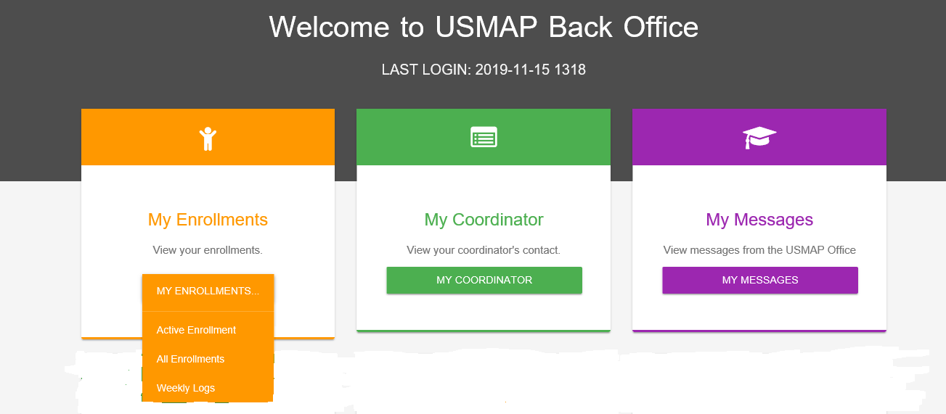
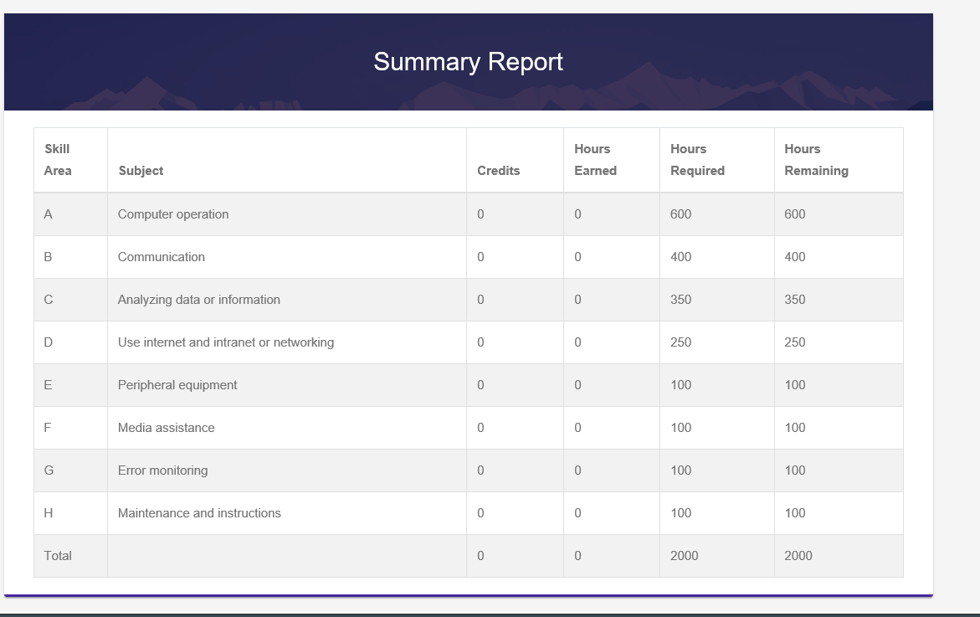
Timed Based Process
When you select “ACTIVE ENROLLMENT” the
summary of hours appears
The “Credit Column” reflects Preregistration Credit Hours if awarded

Slide 30
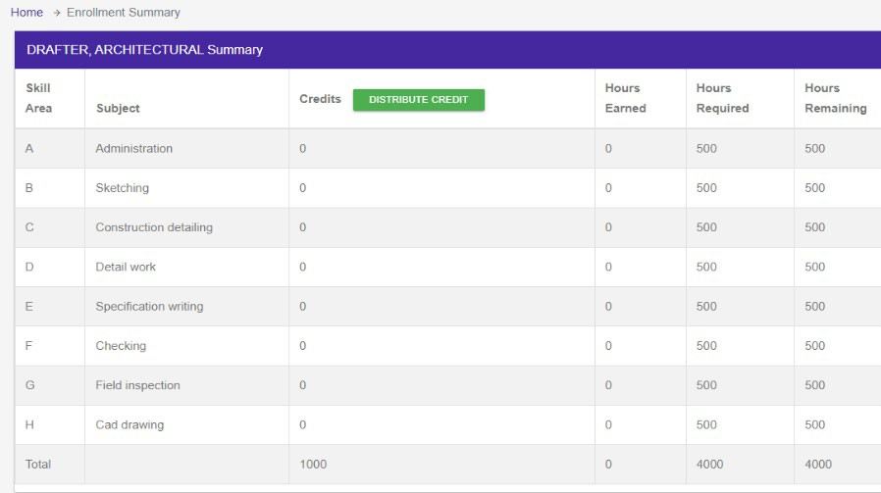
Timed Based Process
How to divide pre-registration credit hours
Click distribute Credit
If you received the maximum 50%, the system will automatically distribute those hours for you.
If you receive less than 50%, it is YOUR RESPONSIBILITY to distribute preregistration credit hours awarded to you
Above is the “Enrollment Summary” sample. In this example, the 1,000 hours of preregistration credit hours was awarded. If you receive less than maximum hours (50%), the best way to distribute the hours is to take a look at your WPS. Read each “Skill Area” and then determine the total of hours to be distributed.

Slide 31
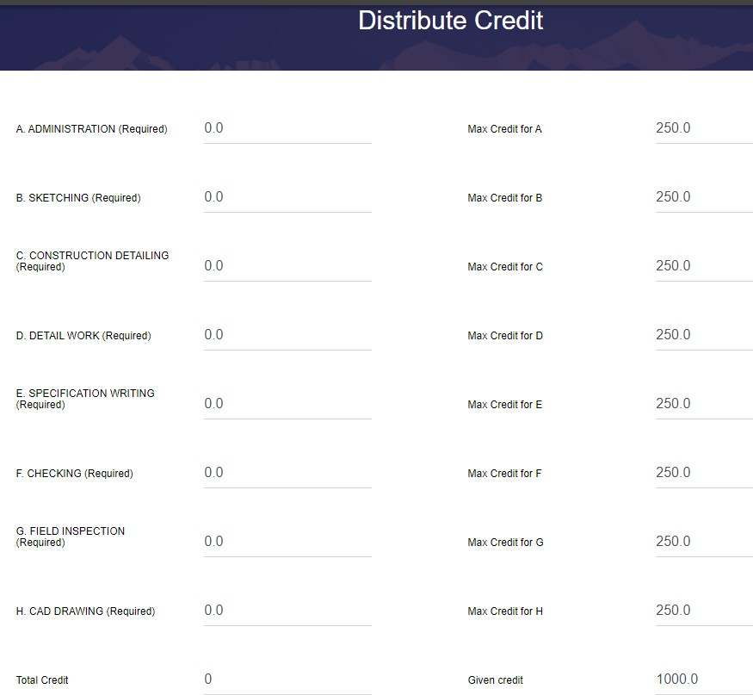
Timed Based Process
When you have entered your hours, click “Save Changes.”
How to Divide Preregistration Credit Hours Continued
When you click on “Distribute Credit”, below is what you will see.
The Pre-Registration Credit Hours for a “Skill Area” may not exceed 50% of the hours required for that “Skill Area”.

Slide 32
Timed Based Process
When you have entered your hours, click “Save Changes.”
How to Divide Preregistration Credit Hours Continued
When you click on “Distribute Credit”, below is what you will see.
125.0
125.0
125.0
125.0
125.0
125.0
125.0
125.0
When you have entered your hours, click “Save Changes.”
1000.0

Slide 33
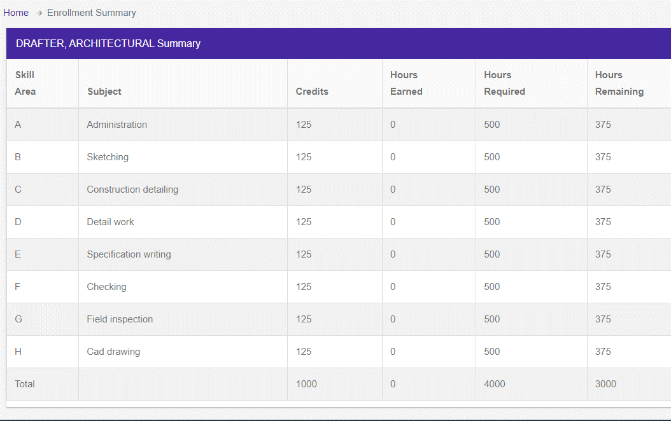
Timed Based Process
How to divide pre-registration credit hours
When you click on “SAVE CHANGES”, below is what you will see.
NOTE: Hours Remaining will not change until monthly report is approved.
NOTE: Once distributed and save, these hours cannot be changed.

Slide 34
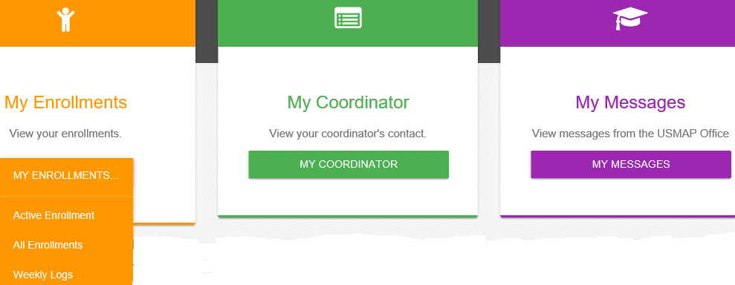
Timed Based Process
Weekly Log Process
Member selects Weekly Logs
Select week starting date from calendar example (09NOV2019) NOTE: All weeks must start on a Saturday and end on the next Friday.

Slide 35
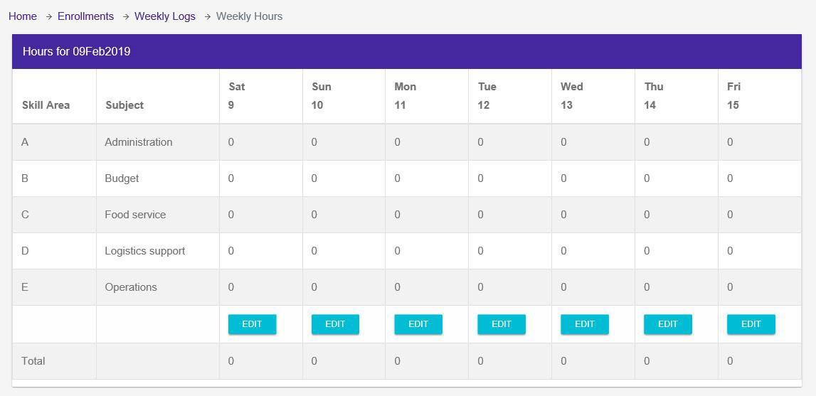
Timed Based Process
Weekly Log Process
New weekly log created by selecting “Edit” to enter hours.
NOTE: Each Skill Area starts With A B, C, etc. Enter hours worked each day in the skill areas that corresponds to your WPS

Slide 36
Timed Based Process
Weekly Log Process
Note: The Edit button will not be active until the actual day of/or has passed. You cannot log hours to future dates.

Slide 37
Timed Based Process
Rules of Reporting Hours
You record the hours you work according to your Trade’s WPS. Each skill area is broken down by a letter of the alphabet. Record the daily hours you work using the skill area A, B, C.
All weeks entered will start on Saturday and end on the following Friday.
USMAP is a windshield program; not a rear view. You can only log hours from the enrollment day forward. The U.S. Department of Labor does not allow backdating, you can only log hours from the date of enrollment.
Trades are automatically cancelled after 18 months without any activity in a Trade.
NOTE: The hours logged are not to be reflective of your workday. The hours logged shall be the actual hours doing the specific tasks that align to the Trade’s Work Processes Schedule (WPS). Time spend having meals, at PT, standing watch, etc. and all other activities that don’t align to a WPS Skill Area do not get logged.

Slide 38
Timed Based Process
Rules of Reporting Hours Continued
Remember, this is a voluntary program. By participating or certifying a trade in USMAP, you are attesting that you have read the National Apprenticeship Standard and the USMAP Program Guide in their entirety. This program is a joint effort between the Department of Defense (DoD) and Department of Labor (DoL) resulting in a serialized DoL certificate recognized nationally. Defrauding a Federal Agency in uniform is in direct violation of
923.18 U.S.C. § 371 and Article 107 of the Uniform Code of Military Justice (UCMJ). Fraudulent reporting/certifications will result in trade cancellation and commands will be contacted for investigation assignment. It is imperative that all service members involved in this program read, understand, and follow the program guidelines as written.
Tracking Your Hours
You are required to document the OJT hours worked for your Trade. Enter hours worked for each skill area from the WPS for the week. Hours must be logged in full- or half-hour increments (example: 0.5, 1.0, 1.5, 2.0, etc).
To help keep track of your hours, you can print a Work Experience Hourly Record Form (located on website under the “Resources and Links” tab). As you work the skill areas, you can use it to document your daily hours as they happen. At the end of the work day, all you have to do is transfer the hours from the document to the online Weekly log.
Time you cannot log: Military duties, training not outlined in your WPS. For example: eating, working parties, sleeping, standing watch, Command PT, medical appointments, etc.

Slide 39
Timed Based Process
Logging Over 8 Hours
You will now be limited to logging up to 10 hours per day when working according to the trade’s WPS to align with the DoD workday. Your Supervisor (E7 and above) must send an email to usmap@navy.mil, if your situation warrants logging more than 8 hours a day, due to deployment or exercise. The email must include the apprentice’s DoD ID Number and justification for a temporary override along with the supervisor’s contact information. NOTE: The hours logged are not to be reflective of your workday. The hours logged shall be the actual hours doing the specific tasks that align to the Trade’s Work Processes Schedule (WPS). Time spend having meals, at PT, standing watch, etc. and all other activities that don’t align to a WPS Skill Area do not get logged.
Logging Your Hours
Example: On Monday, you worked 2 hours performing tasks in Skill Area “A” (example: Preparing reenlistments, entering data on an excel spreadsheet). So, you enter (hours in full or half-hour increments only). You would place 2.0 in block “A” corresponding to Monday.
REMINDER: Do not log 8 hours in each Skill Area. You perform different tasks all day long. Divide the hours up over the skills that you performed.
Saturday is the beginning of the week.
Only log hours worked in skill areas of your Trade work processes schedule. To add hours click “Edit.”

Slide 40
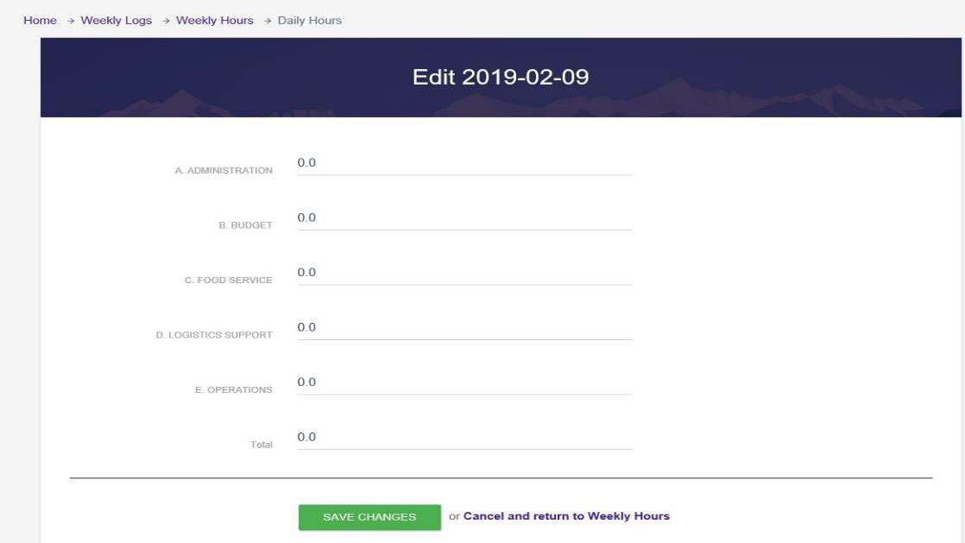
Timed Based Process
To add hours just click on the “0.0” a dark blue line will appear.

Slide 41
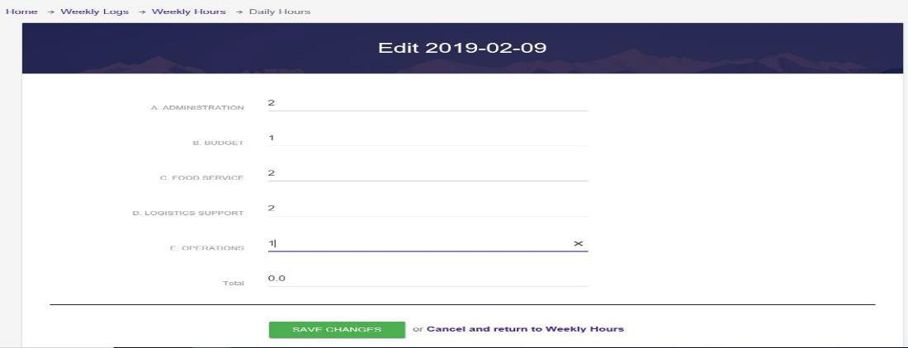
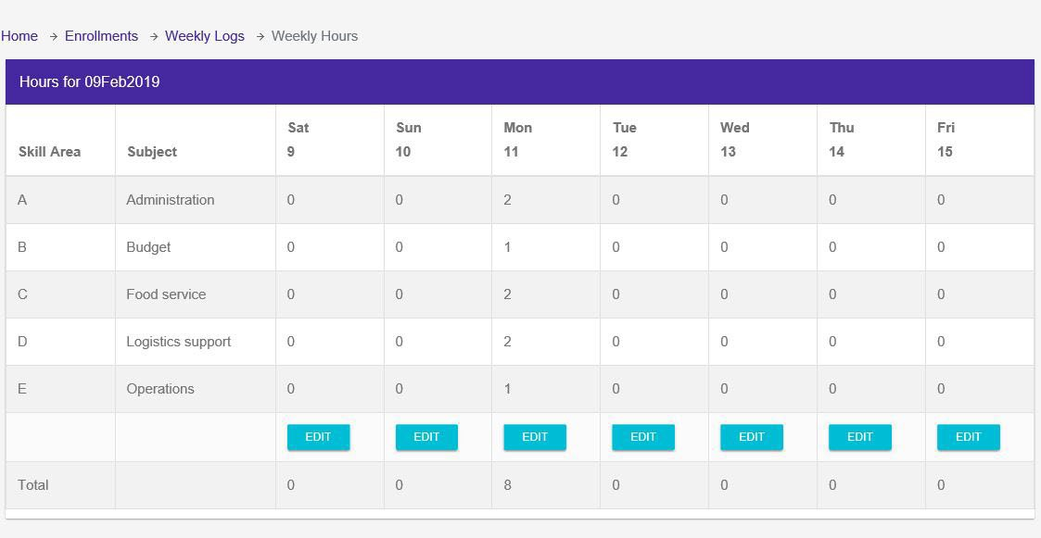
Timed Based Process
After you see the blue line, enter your hours
After you enter the hours, click “SAVE CHANGES.”
When you save the changes, it will take you back to the Weekly Logs page.

Slide 42
Timed Based Process
Monthly
Once you have accumulated four or five weeks of weekly logs, you need to submit your monthly report. Don’t wait until you have accumulated six months worth of monthly logs to submit to your approver. At the end of each month, you need to submit a monthly report to your Supervisor. This person is your first level supervision. Note: Do not submit until all hours for the month have been entered and saved.
Click to submit your monthly report

Slide 43
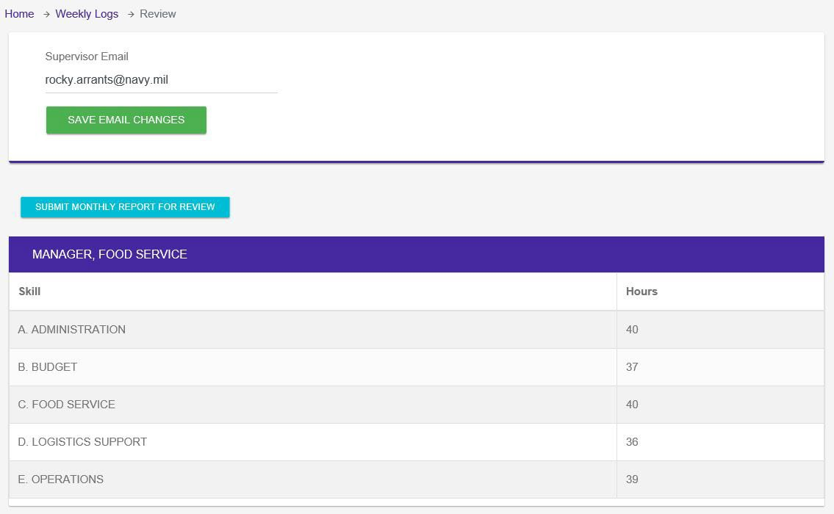
Timed Based Process
Monthly
When you click on “SUBMIT MONTH FOR REVIEW” button This is where you enter your Supervisor’s email. Ensure you type it correctly. Then click “Save Email Changes.”
Once you save the email changes, then click “Submit Monthly Report For Review.” This will send the report to the email you provided.

Slide 44
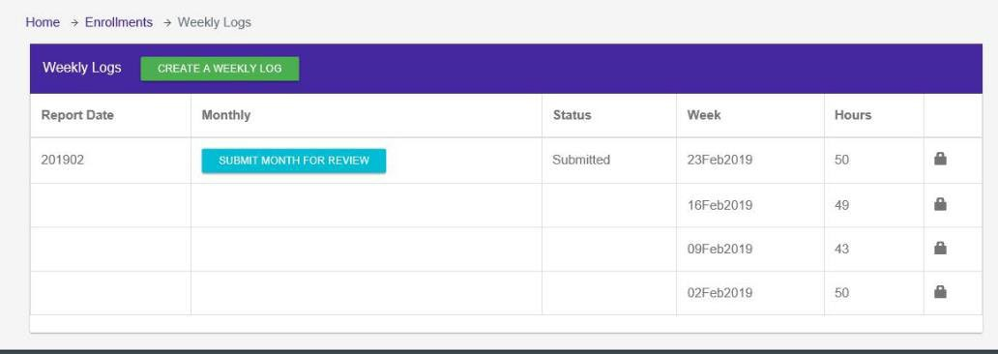
Timed Based Process
Monthly
When you return to the Weekly Log page, this is what the screen will look like.
The status has now changed to “Submitted” and you will notice that those weeks are now locked.
There are two ways to unlock your weeks. First way is if your supervisor rejects your Monthly Report and the second way is to send an email to usmap@navy.mil. If Rejected, the status will change to “Rejected.”

Slide 45
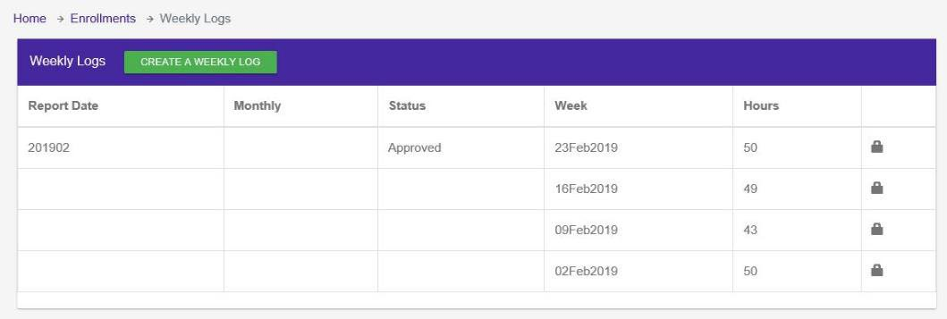
Timed Based Process
Monthly
Once your monthly report approved, you will receive an email to let you know that your report has been approved.
When you go the Weekly Log screen, it will look like this:
Note: Once approved, the Weekly logs contained in the monthly report are locked.

Slide 46
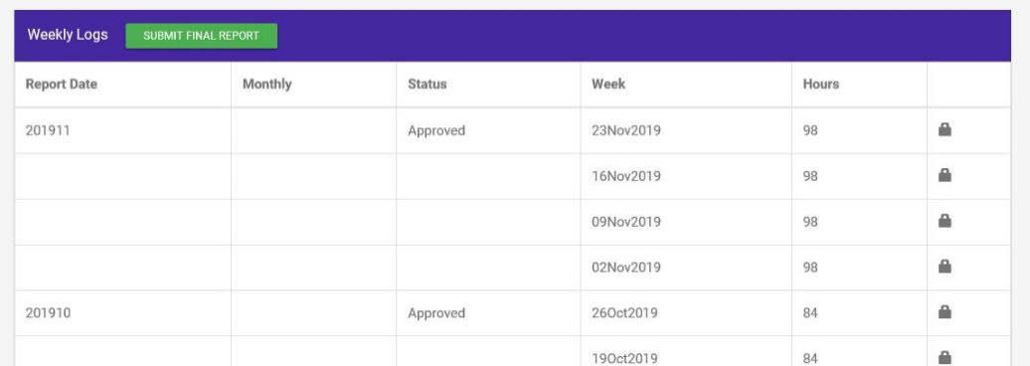
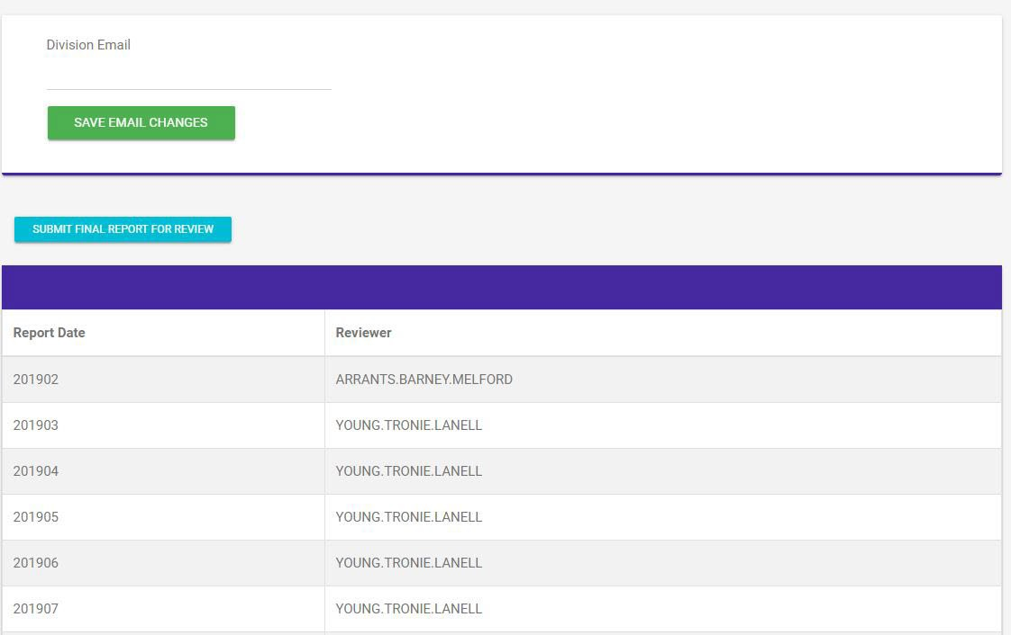
Timed Based Process
Final Report
Once all Skill Areas are “zeroed” out, you must submit your final report.
Enter your Approver’s email. Must be a commissioned officer that is in your chain of command.
After you done entering your approver’s email, click “Save Email Changes.”
Then click “Submit Final Report for Review.” This will send an email link to your Approver.

Slide 47
Timed Based Process
Final Report
Once the approver has approved your final report, log back into your record and you will be able to print or download your own Department of Labor Completion certificate and Journeyworker Card, and reprint as needed in the future.

Slide 48
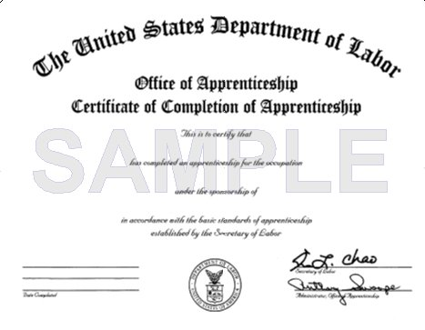
Timed Based Process
Certificate and Journeyworker Card
You can reprint your certificate and journeyworker card as needed as needed in the future with CAC access. Once you leave the military, you will have to request a copy of your DOL certificate and journey worker card by email the USMAP Office.
Notice! This is not an USMAP Completion Certificate and Journeyworker card -rather it is a certificate issued by the Department of Labor and should be referred to as such. Note It is recommended that you print or save the trades Work Processes Schedule and keep it along with your Department of Labor Completion Certificate. It might be useful once you transition to a civilian.

Slide 49
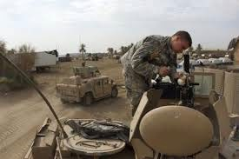
USMAP INFORMATION
Web site: https://usmap.osd.mil/ E-mail: usmap@navy.mil or usmap@livehelpnow.net
Phone: | 1-850-452-6699
DSN: | 459
FAX: | 850-452-6897

